Slide 1





Course Name object oriented analysis and design
CSC 2210
(Undergraduate)
Software engineering (Undergraduate)
Chapter 10 design pattern
Victor Stany Rozario
Assistant Professor
Department of Computer Science, AIUB
Web: https://cs.aiub.edu/profile/stany

Slide 2
What is design pattern?
S.2
A design pattern describes a problem that occurs over and over in software engineering
And then describes the solution in a sufficiently generic manner as to be applicable in a wide variety of contexts.

Slide 3
Typical pattern format
S.3
The pattern name
The problem
Specification of the problem
Explanation why it is important
Applications
Examples of known uses

Slide 4
Software measurement
S.4
The solution
A description of classes possibly with a structure diagram
A language independent implementation, with language-specific issues as appropriate
Sample code
Consequences
Results
Trade-offs of using the pattern
A discussion of related patterns

Slide 5
singleton
S.5
The Singleton pattern ensures you have at most one instance of a class in your application (One of a Kind Objects)
For example, in a system there should be only one window manager (or only a file system or only a print spooler)
If more than one instantiated: Incorrect program behavior, overuse of resources, inconsistent results

Slide 6
The Little Singleton
S.6
new MyObject ( );
How would you create a single object?
And what if another object wanted to create a MyObject? Could it call new on MyObject again?
Can we always instantiate a class one or more times?
And if not?
Is this possible? public class MyClass { private MyClass ( ) { } }
What does it mean?
Yes.
Yes. Caveat: Only if it is public class
Only classes in the same package can instantiate it - but they can instantiate it more than once.
Yes. It is a legal definition
A class that can’t be instantiated because it has a private constructor

Slide 7
The Classic Singleton Pattern
S.7
public class Singleton {
private static Singleton uniqueInstance;
// other useful instance variables
private Singleton ( ) { }
public static Singleton getInstance ( ) {
if (uniqueInstance == null) {
uniqueInstance = new Singleton ( );
}
return uniqueInstance;
}
// other useful methods
}
Constructor is declared private; only singleton can instantiate this class!
We have a static variable to hold our one instance of the class Singleton.
The getInstance ( ) method gives us a way to instantiate the class and also return an instance of it.
Of course, Singleton is a regular class so it has other useful instances and methods.

Slide 8
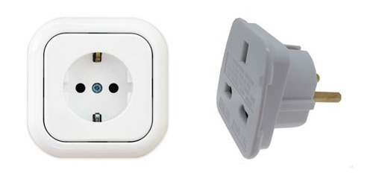
adapter
S.8
An adapter is used when you need to use an existing class, but its interface is not the one you need
An adapter changes an interface into one that a client expects.
“Putting a Square Plug in a Round Socket”
Implementing an adapter may require little work or a great deal of work depending on the size and complexity of the target interface.
An adapter wraps an object to change its interface, a decorator wraps an object to add new behaviors and responsibilities.

Slide 9
adapter
S.9
Scenario: you have an existing software system that you need to work a new vendor library into it, but the new vendor designed their interfaces differently than the last vendor
What to do?
Write a class that adapts the new vendor interface into the one you’re expecting
Your Existing
System
Vendor
Class
Their interface doesn’t match the one you’ve written your code against. Not going to work!
Your Existing
System
Vendor
Class
Adapter
No code changes
New code
No code changes

Slide 10
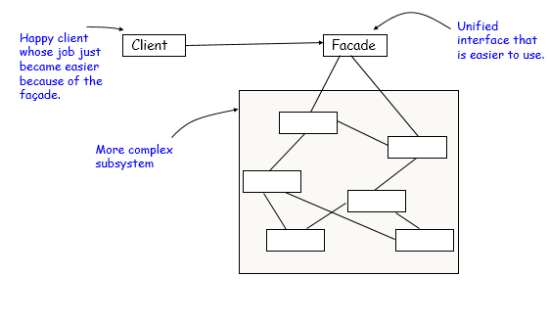
FAÇADE
S.10
A façade is used when you need to simplify and unify a large interface or a complex set of interfaces
The Façade Pattern provides a unified interface to a set of interfaces in a subsystem. Façade defines a higher-level interface that makes the subsystem easier to use
A façade decouples the client from a complex subsystem
Implementing a façade requires that we compose the façade with its subsystem and use delegation to perform the work of the façade
A façade “wraps” a set of objects to simplify
This pattern hides all the complexity behind

Slide 11
observer
S.11
Observer pattern is used when there is one-to-many relationship between objects such as if one object is modified, its dependent objects are to be notified automatically
Example: when you subscribe to your local newspaper agent, every time there is a new edition, it gets delivered to you
It is mainly used to implement distributed event handling systems

Slide 12
Strategy
S.12
Strategy pattern allows selection of one of several algorithms dynamically
In Strategy pattern, a class behavior or its algorithm can be changed at run time.
Strategies don’t hide everything -- client code is typically aware that there are a number of strategies and has some criteria to choose among them -- shifts the algorithm decision to the client.
In Strategy pattern, we create objects which represent various strategies and a context object whose behavior varies as per its strategy object. The strategy object changes the executing algorithm of the context object.

Slide 13
factory
S.13
When a method returns one of several possible classes that share a common super class
Class is chosen at run time
Factory pattern allows to create objects without specifying the exact class of object that will be created

Slide 14
references
R.S. Pressman & Associates, Inc (2010). Software Engineering: A Practitioner’s Approach.

